Slide 1

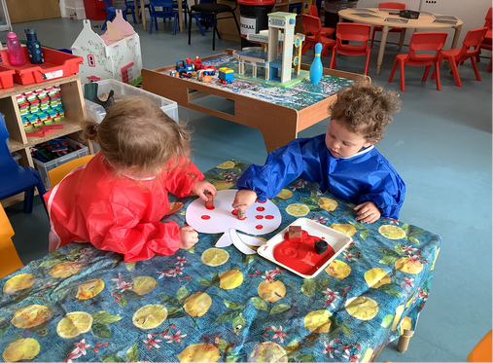
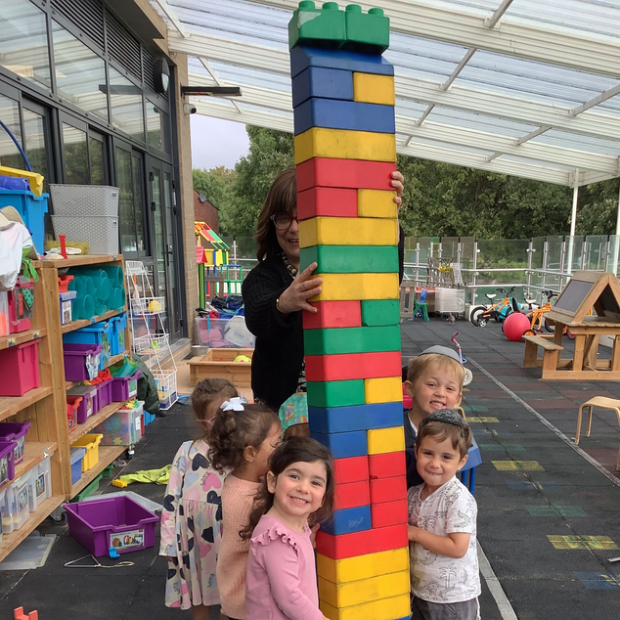
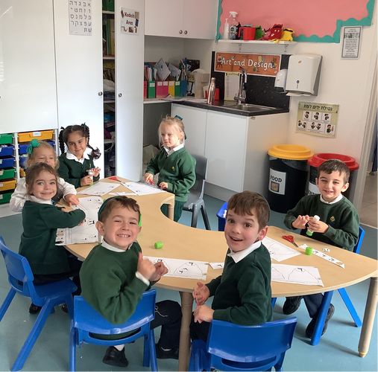
Is your child due to start
Nursery or Reception in September 2026?
We would like to welcome you to our Open Day on
Tuesday 11th November 2025
9.30am – 11am
Come and experience the warm, welcoming atmosphere of Shalom Noam
Meet the Headteacher, Head of Kodesh, Governors, Staff and some of our delightful pupils
Join a tour of the school and see learning in action
Please email office@shalomnoam.org to register for the tour
Please ensure you respond by Thursday 6th November 2025
If you have any questions, please call the school office:
020 8908 9491 or email office@shalomnoam.org
www.shalomnoam.org

